Slide 1

Highlights of New Wild Poliovirus and cVDPV Positives Reported Globally this Week
¹contacts of positive AFP cases, community, healthy children
The boundaries and names shown, and the designations used in the maps in this document do not imply the expression of any opinion whatsoever on the part of the World Health Organization concerning the legal status of any country, territory, city or area or of its authorities, or concerning the delimitation of its frontiers or boundaries. Dotted lines on maps represent approximate border lines for which there may not yet be full agreement. As of 27 May 2025, Indonesia is part of the Western Pacific Region and no longer of the South-East Asia Region. © WHO 2025. All rights reserved

Slide 2
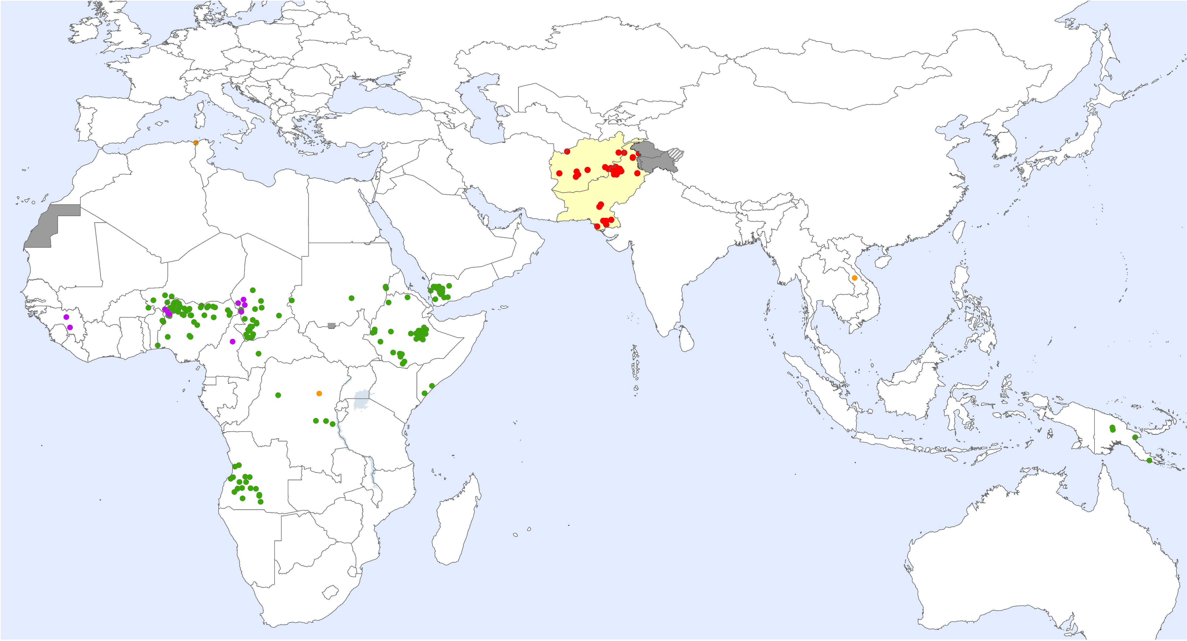
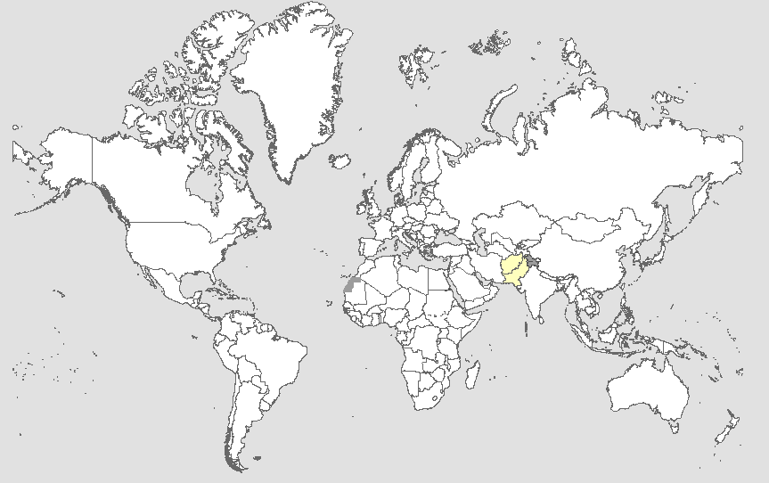
Global WPV1 & cVDPV Cases¹, Previous 12 Months²
Endemic country (WPV1)
¹Excludes viruses detected from environmental surveillance; ²Onset of paralysis: 21 Jan. 2025 to 20 Jan. 2026

Slide 3
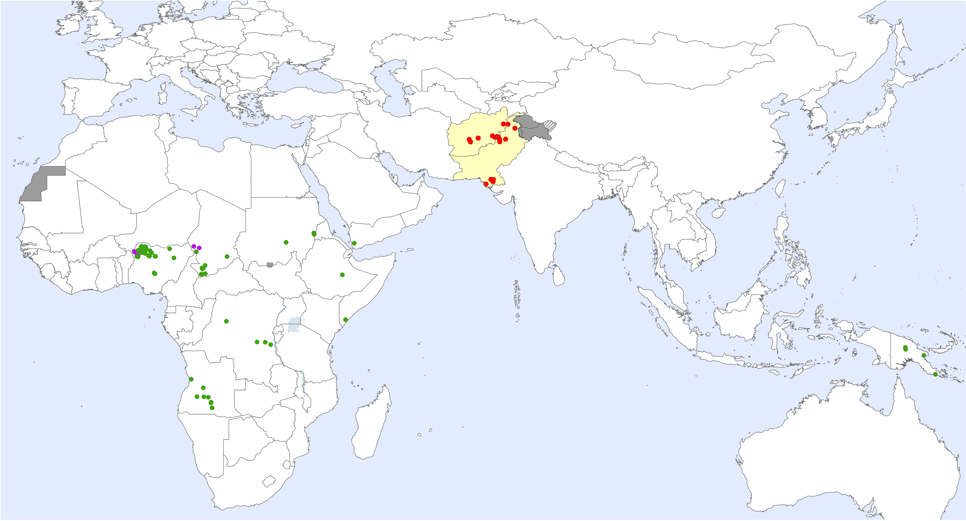
Global WPV1 & cVDPV Cases¹, Previous 6 Months²
Endemic country (WPV1)
¹Excludes viruses detected from environmental surveillance; ²Onset of paralysis: 21 Jul. 2025 to 20 Jan. 2026

Slide 4
Global Wild Poliovirus 2018 - 2025

Slide 5
Global Circulating Vaccine-derived Poliovirus (cVDPV)^{1,2,3}
¹For cVDPV definition see http://polioeradication.org/wp-content/uploads/2016/09/Reporting-and-Classification-of-VDPVs_Aug2016_EN.pdf. ² Include contact, healthy and community samples. ³cVDPV1 and cVDPV2 isolated from four children (3 in 2022 and 1 in 2023)

Slide 6
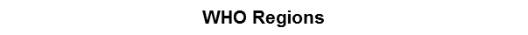
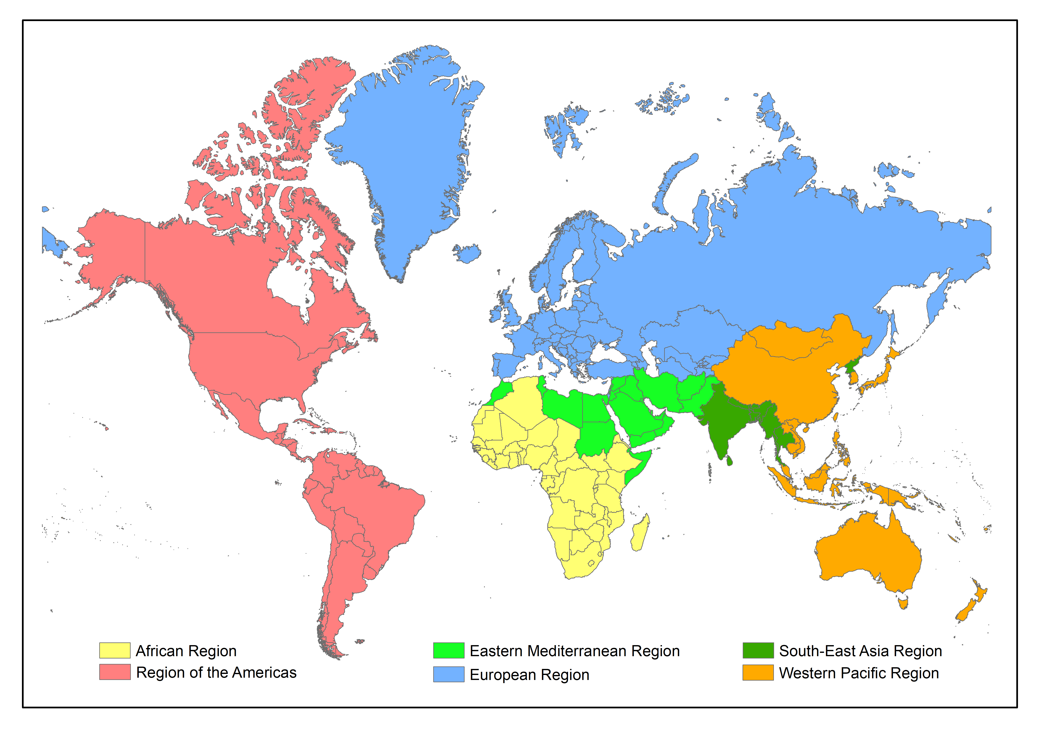
Global Surveillance Indicators: Year to Date Comparison
2024 & 2025: 01 Jan. to 31 Dec. 2025*
¹cVDPV includes all three serotypes 1, 2 and 3. Please refer to slide 5 for the distribution of cases by serotype.
For data at country, regional and global levels from 2000 onwards, see the WHO website at https://extranet.who.int/polis/public/CaseCount.aspx
*Data reported to WHO/HQ on week 04, 2026

